Slide 1
Domain: Ratios and Proportional Relationships
Activity: Name the Ratio
Granite School District
6th Grade

Slide 2
Directions:
  For each picture, write a sentence to describe a ratio relationship between two quantities.
  Name the ratio using math symbols.
  Identify the type of ratio.

Slide 3

1. Stars to moons.

Slide 4




2. Bugs to grasshoppers.

Slide 5
3. Cones to scoops of ice cream.

Slide 6
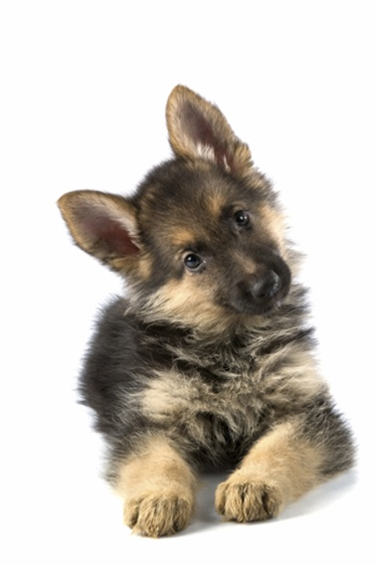


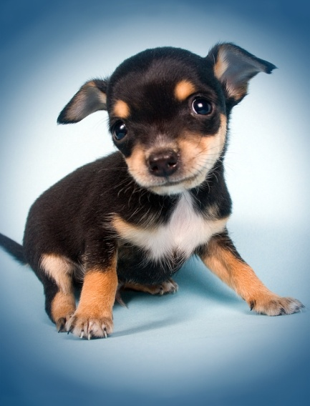

4. Puppies to kittens.

Slide 7




5. Apples to pieces of fruit.

Slide 8
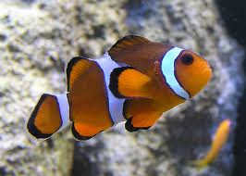
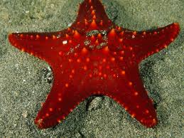
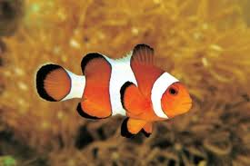
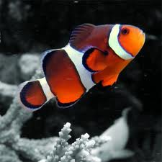
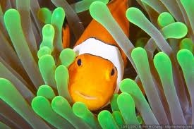
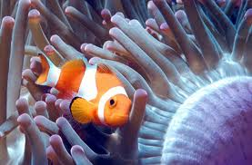
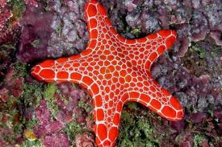
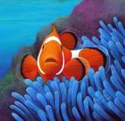
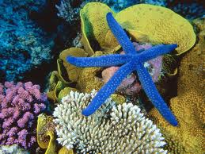
6. Clownfish to starfish.

Slide 9










7. Yellow cars to red cars.

Slide 10









8. Satellites to cell phones.

Slide 11

9. Sneakers to basketballs.

Slide 12

Pizzas to delivery people.

Slide 13
Wheels to bicycles.

Slide 14
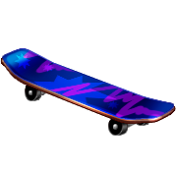


Skateboards to things with wheels.

